Slide 1
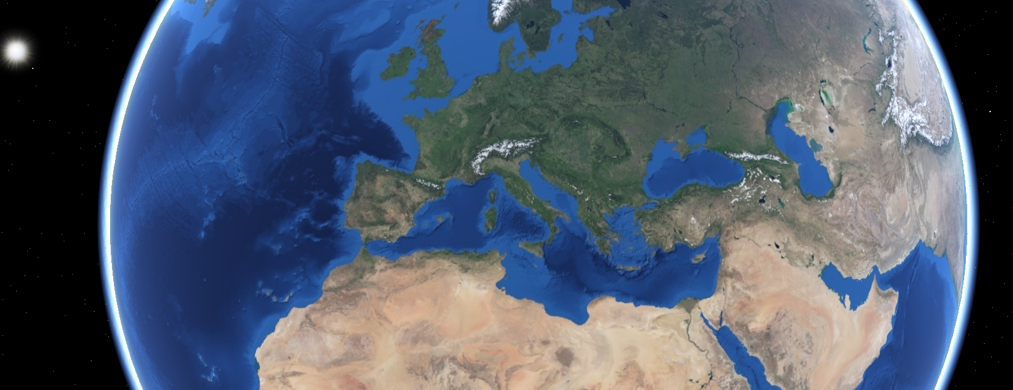

CS16 Group Project Research
Adam Fairlie, Faraj Monnapillai, Harry Goodwin and Philip Coffey
Notes:
Our goal for this sprint was to research what map servers and 3D web technologies were available for displaying a map with layers, lines and polygons, and a simulator that can run on it. We managed to achieve that goal, as well as do some exploratory research into map data and flight tracking API’s. We are also starting to install the technologies required and set up the map server we chose, and are working on a database, although this is far from finished. If you have any questions or comments at any point, feel free to ask.

Slide 2
Map server
Map Servers
Must support OGC standards (Support WMS, WFS files etc)
Must be free to develop with, preferably open source
Would be ideal to be commonly used for reliability and so there is lots of documentation available to help set up and maintain
Notes:
We need a map server that supports OGC standards and that is free to use for any purpose, preferably we are looking for open source. We want a server that has been widely used so we know it is likely to be reliable and will have more information online such as tutorials and forum posts about common issues

Slide 3

Geoserver (Java) http://geoserver.org/
Map Servers
OGC compliant
Open source
One of the most widely used
Good documentation and tutorials
https://docs.geoserver.org/
Support for scripting in Python and JavaScript (among other languages)
https://docs.geoserver.org/stable/en/user/community/scripting/supported.html
Notes:
The first server we looked at is geoserver. It’s OGC compliant and open source and one of the most widely used. It has a lot of documentation and tutorials for most likely anything we’ll need. It also has support for scripting in python and javascript if needed.

Slide 4

Map Servers
Mapserver (C/C++) https://mapserver.org/
OGC Compliant
Open source
The setup process is more complicated
There are less tutorials provided on the website and posts online from people who are creating an app with Mapserver.
Notes:
The next server is mapserver. It is also open source and OGC compliant but the setup process is more complicated and there is less information online on the website and in general.

Slide 5

Map Servers
PyGeoAPI (Python) https://pygeoapi.io/
OGC Compliant
Open source
Easy to use and install
Created for python, which we are very familiar with
More recent technology with less industry use so we may find less help for issues online and less reputation
Notes:
We also explored a library for python, a language we’re very familiar with, which is made to be easy to set up and use. However this is a very recent technology with not much use in peoples projects and not as much online, so we don’t know how reliable it is.

Slide 6
Our choice
Map Servers
We have decided to use Geoserver for our web app
It has better documentation than Mapserver or PyGeoAPI
It is widely used and often considered to be reliable
It is more simple to setup than Mapserver
Notes:
All of those servers are open source and OGC compliant as we needed, we decided to go with GeoServer because there are a lot of resources out there for it, it has a reputation for being reliable, which we wanted for our first project rather than something more new and unproven like pygeoapi, and it’s easier to set up than mapserver which is ideal especially for our first project like this so we can get it set up quicker.

Slide 7
3D Web Front End
3D Web Front End
Must support OGC standards (Support WMS, WFS files etc)
Must be free to develop with, preferably open source
Should have a lot of customisability for implementation of layers, icons and terrain
Should be able to integrate easily with military symbol libraries (milsymbol)
Should be efficient and fast to handle the simulations
Would preferably have a lot of online help resources for setup and common problems
Notes:
For the 3D front end we also wanted something open source which will comply with OGC standards. We wanted something that we could customise and we would be able to implement adding icons, lines and polygons, layers as well as terrain data. We should be able to use the JavaScript military symbol library with it, as there aren’t many others and it would be a huge pain without a library. It should be fast and efficient at animating a lot of objects so it can handle our simulator data, and it would preferably also have a lot of online resources for help. So here are a few we looked at:

Slide 8

3D Web Front End
Worldwind Web (JavaScript) https://worldwind.arc.nasa.gov/web/
OGC Compliant
Open source
Good official tutorials and documentation
https://worldwind.arc.nasa.gov/web/get-started/#anchor
https://worldwind.arc.nasa.gov/web/tutorials/#anchor
https://worldwind.arc.nasa.gov/web/docs/#anchor
https://worldwind.arc.nasa.gov/web/examples/#anchor
Notes:
Worldwind web is a JavaScript framework by NASA. The documentation is very good and the website has a lot of different tutorials for things we might need.

Slide 9
3D Web Front End
Worldwind Web (JavaScript) https://worldwind.arc.nasa.gov/web/
Strong support for 2D and 3D
Shapes and paths provided as a feature and tutorials available
Built-in high-resolution imagery and terrain
Support for layers
https://worldwind.arc.nasa.gov/web/tutorials/layers/
Possible to use with milsymbol but not many resources on achieving this
https://forum.worldwindcentral.com/forum/web-world-wind/web-world-wind-help/158429-dynamic-imagesource-in-the-placemark-attributes
Notes:
It has support for 2D and 3D maps, shapes and paths, high resolution images with terrain data, as well as support for layers, and it has tutorials for a lot of these things on the website. It seems like it is possible to use the milsymbol library with it but there isn’t much online about people trying, the most relevant thing I could find is a brief forum post of someone who got it to work, the built in symbols aren’t APP-6.

Slide 10

3D Web Front End
CesiumJS (JavaScript) https://cesium.com/platform/cesiumjs/
OGC Compliant
Open source
Good documentation for getting started and implementing many planned features
https://cesium.com/learn/cesiumjs-learn/
Very powerful for drawing 2d and 3d polygons:
https://www.safe.com/blog/2018/08/bring-2d-data-cesiumjs/
Can integrate easily with Geoserver and there are tutorials:
https://dale-bingham-cingulara.medium.com/a-cesiumjs-starter-kit-with-geoserver-a96bfe767ba2
Notes:
The next library we looked at is cesium. It has very strong documentation and tutorials for things we need like layers, lines and polygons and terrain data. It is also considered very powerful for drawing 2D and 3D polygons which will help in our simulations. There are a lot of tutorials on how we can integrate it with geoserver.

Slide 11
3D Web Front End
CesiumJS (JavaScript) https://cesium.com/platform/cesiumjs/
Support for terrain such as SRTM:
https://cesium.com/platform/cesium-ion/content/cesium-world-terrain/
Can be used for 2D maps
https://live.osgeo.org/en/quickstart/cesium_quickstart.html#switch-between-3d-2-5d-and-2d
Compatibility with the open source APP-6 military symbol library:
https://github.com/spatialillusions/milsymbol
https://cesium.com/blog/2016/07/20/cesium-and-milsymbol/
Can be used to create simulations with flight data
https://cesium.com/blog/2020/08/13/flightradar24/
Notes:
There are tutorials on things like terrain, layers and using 2D and 3D. Cesium also has an excellent blog with articles on how to use the milsymbol library and how to animate a path like we will need to do for the simulator.

Slide 12

3D Web Front End
Google Earth Enterprise (JavaScript) https://www.opengee.org/
OGC standard protocols
Open source
Has a lot of documentation
https://www.opengee.org/geedocs/5.3.8/index.html
2D, 3D and terrain capabilities
Less commonly used so likely less help available online
Less information on integration with milsymbol, flight data etc
Notes:
We also looked at google earth enterprise, which has a lot of good documentation but isn’t used as much and might be harder to integrate with military symbols or flight data because there’s not as much available online for that.

Slide 13
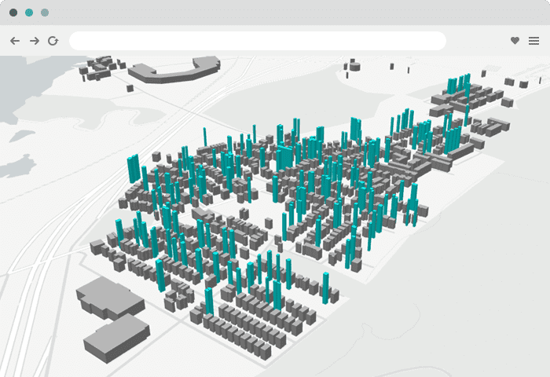
3D Web Front End
Maptalks (JavaScript) https://maptalks.org/
Open source
Support for 2D and 3D
Support for layers
https://github.com/maptalks/maptalks.js/wiki/Layer
Support for drawing lines and polygons
https://maptalks.org/examples/en/interaction/draw-tool/
No mention of OGC standards
Less extensive documentation/less widely used
Notes:
We also looked at a library called Maptalks which has at least most of the features we need, but it is nowhere near as widely used and doesn’t mention OGC standards.

Slide 14
Our choice
3D Web Front End
We have decided to use CesiumJS for our web app.
Both WorldWind and Cesium are well documented and have all required functionality
Cesium has more resources on integration with APP-6 symbols, flight tracking, working with geoserver etc.
Notes:
We chose cesium because along with worldwind, they are the widely used and well documented frameworks. We chose cesium because there are a lot of useful blogs on their site and others with tutorials on how to set it up with pretty much every other technology we’ll need for the project.

Slide 15
Map data
Map data
Most of the map data needed is provided through geoserver and cesium.
We may want extra information for city names and borders etc.
We would like this data to be focused on the UK (preferably Glasgow/Scotland)
Should be in OGC forms (WMS, WFS etc)
Notes:
We looked into some data we could use in our application. Most of the data we need is available through cesium and geoserver already, including terrain data, but this is mostly just geographical features. We might want more specific area maps to highlight things like city names and borders, or many maps of streets and buildings. We should make sure that any map data we find is in an OGC compliant form like web map service or web feature service)

Slide 16

Map data
OS OpenData https://osdatahub.os.uk/
Data is available in many formats
Boundary maps of UK regions, maps of cities, towns and road networks,
Postcodes, green spaces
Centred on Great Britain
Notes:
The Ordnance Survey open data website is excellent for maps of the UK in many different formats. It include boundary maps, maps of cities, towns and road networks, postcode maps, maps of green spaces etc. which is all centred on great britain

Slide 17

Map data
Open Geography Portal https://geoportal.statistics.gov.uk/
From the Office for National Statistics (ONS) in the UK
Provides shapefiles (feature layers)
Many constituency maps and boundary maps
Notes:
The Open Geography Portal is a website run by the Office for National Statistics in the UK, and it provides a lot of constituency maps and boundary maps as feature layers which we could use on Cesium

Slide 18

Scottish Spatial Data Infrastructure https://www.spatialdata.gov.scot/
Map data
Maps and features provided by the Scottish government
Centred on Scotland
Thousands of maps across a huge range of categories
Forest maps, broadband coverage, waste management and gas coverage
Notes:
The Scottish Spatial Data Infrastructure is a website run by the Scottish government which provides thousands of maps of different things centred around Scotland, including standard boundary and constituency maps but also things like forest maps, broadband coverage maps, gas network maps and maps for waste management centres. It’s likely that we’ll at least explore these maps if we can get the main features built in.

Slide 19
Simulator data
Simulator
We may decide to create our own simulator data (randomly generate icons and paths for them to animate across) or use data such as ADS-B to provide real-world data to simulate
Creating our own simulator would be more customisable and less reliant on external services
No internet connection would be required if we had no feed to receive data from
Real-world data will be more useful to show the app in a context in which it would be used.
We will create a simulator using generated values, and using an API for live data will be a stretch goal
Notes:
For our simulator, we could use our own random or manually created paths to animate our icons moving through, or we can use data such as AIS for ships or ADS-B for planes. As the web app needs to work offline, we need to have some sort of simulator which can work without an offline feed, so we’ll focus on manually creating a simulator. This gives us more freedom for customisation and we don’t have to rely on for example if we have 1000 flights to animate, or the limitations of any API’s we use. If we have time, we’ll try to implement flight data.

Slide 20

Simulator
ADS-B Interface (JSON REST API) https://openskynetwork.github.io/opensky-api/rest.html#
Free to use (AIS and ADS-B data is very rarely free)
Provides JSON data which can easily be extracted to use in our program
Data is available for up to an hour in the past if we create an account
We can specify areas (latitudes and longitudes) to receive data for
We can only have data samples for every 5 seconds
We can’t guarantee we will have 1000+ icons at any given time
Notes:
The best interface we could find for live feeds is ADS-B through opensky. Almost every other live feed for ships or planes is a paid subscription. There is a decent amount of customisaton in the requests, for example we can choose bounds for planes. The data has limitations, it can only go an hour in the past and it only updates every 5 seconds, but it should be enough to animate.

Slide 21
Design
Block diagram
Simulator
(Arbitrary data)
3D Web Front End
(CesiumJS)
Live ADS-B feed
(OpenSky)
(This is a stretch goal)
Map
requests
Maps following OGC Standards
Map data
Map server
(Geoserver)
Notes:
Here is our updated block diagram to reflect the technologies we’ve chosen to use

Slide 22
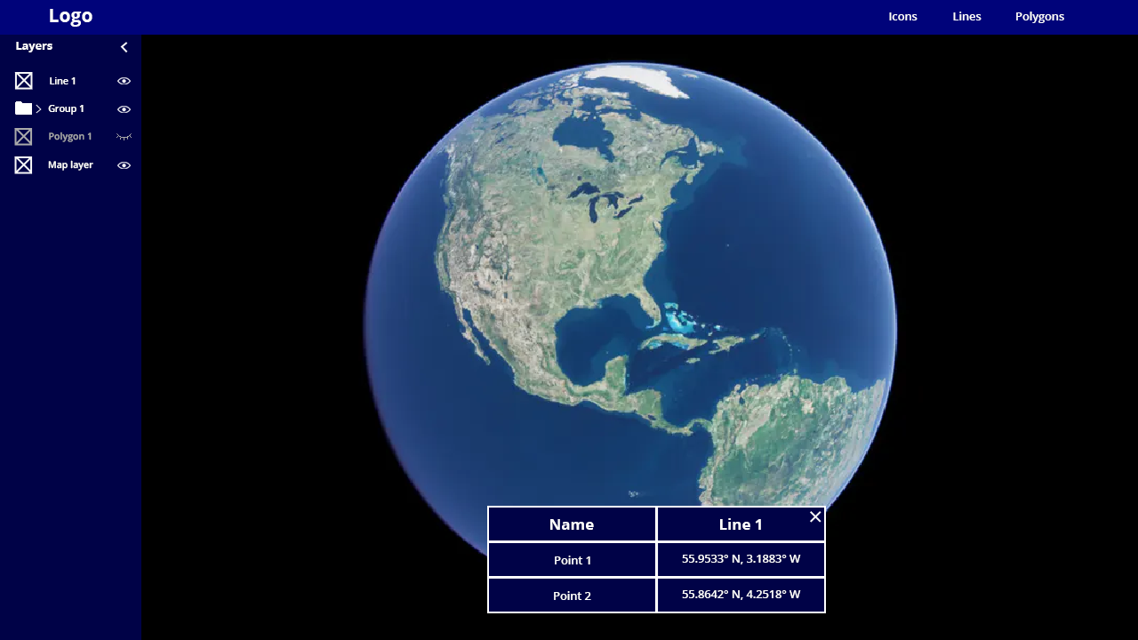
Design
Wireframe
Notes:
Here is a wireframe of the general layout, the fonts and colours are likely to change

Slide 23
Design
Wireframe
Add icons and shapes
Collapsible Layers
Groups (stretch goal)
Layer visibility toggling
Collapsible table
Notes:
We will have a toolbar with a logo and options to put icons, lines and shapes on the map. We’ll have a layers panel which can be collapsed with an arrow at the top or something similar and every layer can be turned on or off. We’re hoping if we have time to add the ability to group layers so they can be toggled on and off together. We also plan to have a table which will come up if you click on an element with some extra information, which can be closed with some sort of X button.

Slide 24
Next Sprint: Delivering the first Prototype
Notes:
If you have any questions about this presentation or anything else, I’m happy to take them now, and then we’ll go on to planning the next sprint

